Slide 1
Web Security
Security, Privacy, and Consumer Protection Nick Feamster University of Chicago

Slide 2
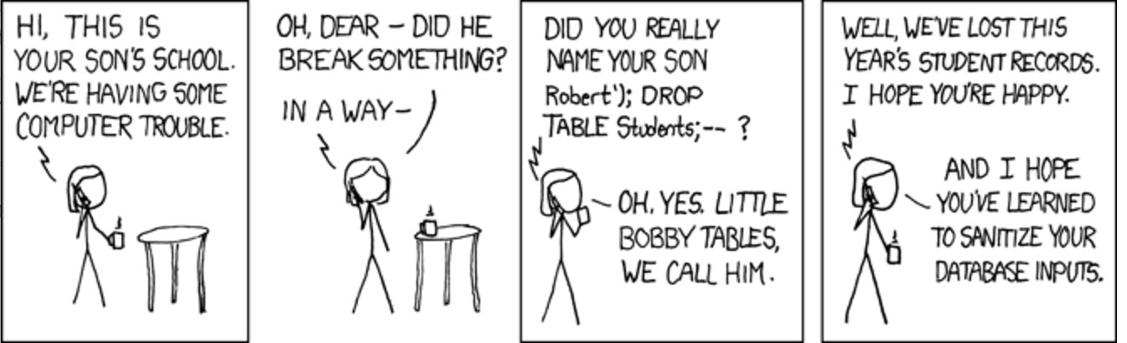
Notes:
https://imgs.xkcd.com/comics/exploits_of_a_mom.png

Slide 3
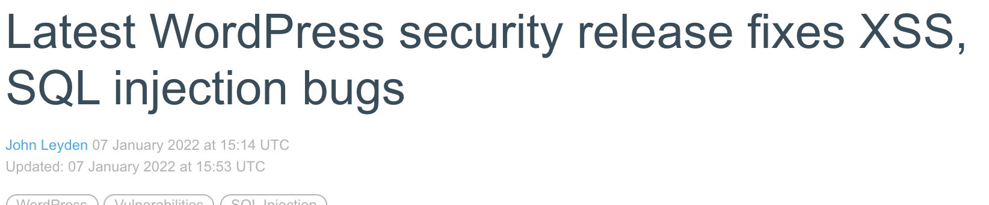

Slide 4
Browser Security
Goal: Prevent a malicious site from spying on or tampering with (1) my information or (2) interactions with other websites
Browsing to evil.com should not let evil.com spy on my emails in Gmail or buy stuff with my Amazon account
Defense: the same-origin policy
A security policy grafted on after-the-fact, and enforced by web browsers
Intuition: each web site is isolated from all others

Slide 5
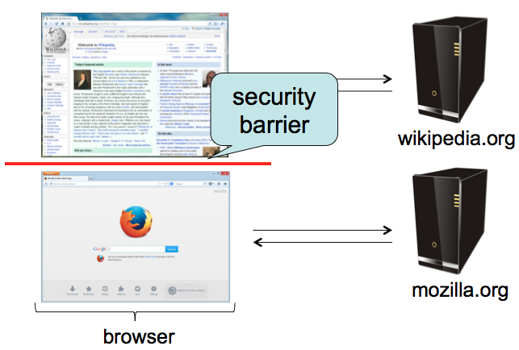
Same-Origin policy
Each site is isolated from all others

Slide 6
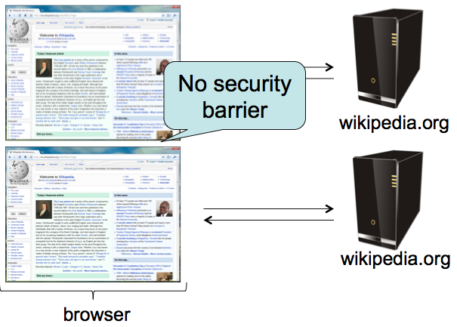
Same-Origin Policy
Multiple pages from same site aren’t isolated

Slide 7
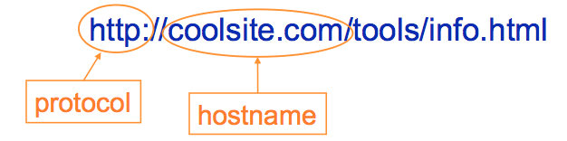
Same-Origin Policy
Granularity of protection: the origin
Origin = protocol + hostname + port
Javascript on one page can read, change, and interact freely with all other pages from the same origin

Slide 8
Same-Origin Policy
Browsers provide isolation for JS scripts via the Same Origin Policy (SOP)
Simple version:
Browser associates web page elements (layout, cookies, events) with a given origin ≈ web server that provided the page/cookies in the first place
Identity of web server is in terms of its hostname, e.g., bank.com
SOP = only scripts from a web page’s origin have access to page’s elements
XSS: Subverting the Same Origin Policy

Slide 9





Web Overview (HTTP)
GET / HTTP/1.1 Host: gmail.com
HTTP/1.1 200 OK … <html>
<head>
<script>alert(‘Hi!’)</script>
</head>
<img src=“//gmail.com/img.png”/>
https://gmail.com/ says: Hi!
gmail.com
GET /img.png HTTP/1.1 Host: gmail.com
HTTP/1.1 200 OK … <89>PNG^M ...
Notes:
Fetching image, not script

Slide 10


Same-Origin Policy
https://gmail.com/ says: { new_msgs: { from: “Bob”, msg: “Hi!”}}
gmail.com
$.get(‘https://gmail.com/chat.json’, function (data) { alert(data); })
GET /chat.json HTTP/1.1 Host: gmail.com
HTTP/1.1 200 OK … { new_msg: { from: “Bob”, msg: “Hi!”}}
Notes:
XMLHttpRequest cannot load https://gmail.com/. No 'Access-Control-Allow-Origin' header is present on the requested resource. Origin 'null' is therefore not allowed access.

Slide 11

AJAX (jQuery Style)
GET / HTTP/1.1 Host: gmail.com
HTTP/1.1 200 OK …
<script> $.get(‘https://gmail.com/msgs.json’, function (data) { alert(data) }); </script>
https://gmail.com/ says: { new_msgs: 3}
gmail.com
$.get(‘https://gmail.com/msgs.json’, function (data) { alert(data) });
GET /msgs.json HTTP/1.1 Host: gmail.com
HTTP/1.1 200 OK … { new_msgs: 3 }
Notes:
Fetching and executing script from same origin

Slide 12



Same-Origin Policy: Scripts
(evil!) facebook.com
GET / HTTP/1.1 Host: facebook.com
HTTP/1.1 200 OK … <script> $.get(‘https://gmail.com/msgs.json’,
function (data) { alert(data); }
</script>
$.get(‘https://gmail.com/msgs.json’,
function (data) { alert(data); }
GET /msgs.json HTTP/1.1 Host: gmail.com
gmail.com
HTTP/1.1 200 OK … { new_msgs: 3 }
Notes:
Trying to execute script from different origin.
XMLHttpRequest cannot load https://gmail.com/. No 'Access-Control-Allow-Origin' header is present on the requested resource. Origin 'null' is therefore not allowed access.

Slide 13
Same-Origin Policy: Objects
GET / HTTP/1.1 Host: facebook.com
facebook.com
HTTP/1.1 200 OK … <img src=“https://gmail.com/img.png”/>
?
gmail.com
Notes:
Not a script, just an image: OK.

Slide 14

Same-Origin Policy: Images
GET / HTTP/1.1 Host: facebook.com
facebook.com
HTTP/1.1 200 OK … <img src=“https://gmail.com/img.png”/>
GET /img.png HTTP/1.1 Host: gmail.com
gmail.com
HTTP/1.1 200 OK … <89>PNG^M ...
Notes:
XMLHttpRequest cannot load https://gmail.com/. No 'Access-Control-Allow-Origin' header is present on the requested resource. Origin 'null' is therefore not allowed access.

Slide 15
Same-Origin Policy: <script>
GET / HTTP/1.1 Host: facebook.com
facebook.com
HTTP/1.1 200 OK … <script src=“https://gmail.com/chat.js”/>
?
gmail.com
Notes:
XMLHttpRequest cannot load https://gmail.com/. No 'Access-Control-Allow-Origin' header is present on the requested resource. Origin 'null' is therefore not allowed access.

Slide 16
Same-Origin Policy: <script>
GET / HTTP/1.1 Host: facebook.com
facebook.com
HTTP/1.1 200 OK … <script src=“https://gmail.com/chat.js”/>
$.get(‘https://gmail.com/chat.json’, function (data) { alert(data); })
GET /chat.js HTTP/1.1 Host: gmail.com
gmail.com
HTTP/1.1 200 OK … $.get(‘https://gmail.com/chat.json’, function (data) { alert(data); })
Notes:
XMLHttpRequest cannot load https://gmail.com/. No 'Access-Control-Allow-Origin' header is present on the requested resource. Origin 'null' is therefore not allowed access.

Slide 17
Same-Origin Policy: <script>
$.get(‘https://gmail.com/chat.json’, function (data) { alert(data); })
gmail.com
GET /chat.json HTTP/1.1 Host: gmail.com
HTTP/1.1 200 OK … { new_msg: { from: “Bob”, msg: “Hi!”}}
Notes:
XMLHttpRequest cannot load https://gmail.com/. No 'Access-Control-Allow-Origin' header is present on the requested resource. Origin 'null' is therefore not allowed access.

Slide 18
Same-Origin Policy: IFrame
GET / HTTP/1.1 Host: facebook.com
facebook.com
HTTP/1.1 200 OK … <iframe src=“https://gmail.com/chat”/>
?
gmail.com
Notes:
XMLHttpRequest cannot load https://gmail.com/. No 'Access-Control-Allow-Origin' header is present on the requested resource. Origin 'null' is therefore not allowed access.

Slide 19
Same-Origin Policy: IFrame
GET / HTTP/1.1 Host: facebook.com
facebook.com
$.get(‘https://gmail.com/chat.json’, function (data) { alert(data); })
HTTP/1.1 200 OK … <iframe src=“https://gmail.com/chat”/>
GET /chat HTTP/1.1 Host: gmail.com
gmail.com
HTTP/1.1 200 OK … <script> $.get(‘https://gmail.com/chat.json/’, function (data) { alert(data); }); </script>
Notes:
XMLHttpRequest cannot load https://gmail.com/. No 'Access-Control-Allow-Origin' header is present on the requested resource. Origin 'null' is therefore not allowed access.

Slide 20
Code Injection
<?php
echo system(“ls ” . $_GET[“path”]);
GET /?path=/home/user/ HTTP/1.1
HTTP/1.1 200 OK … Desktop
Documents
Music
Pictures

Slide 21


Code Injection
<?php
echo system(“ls ” . $_GET[“path”]);
GET /?path=$(rm –rf /) HTTP/1.1
<?php
echo system(“ls $(rm –rf /)”);

Slide 22
Code Injection
<?php
echo system(“ls $(rm –rf /)”);
Confusing Data and Code
Programmer thought user would supply data, but instead got (and unintentionally executed) code
Common and dangerous class of vulnerabilities
Shell Injection
SQL Injection
Cross-Site Scripting (XSS)
Control-flow Hijacking (Buffer overflows)

Slide 23
SQL: Structured Query Language
Language to ask (“query”) databases questions:
How many users live in Chicago?
“SELECT COUNT(*) FROM `users` WHERE location = ‘Chicago’”
Is there a user with username “bob” and password “abc123”?
“SELECT * FROM `users` WHERE username=‘bob’ and password=‘abc123’”
Attack!
“DROP TABLE `users`”

Slide 24
SQL Injection
Consider an SQL query where the attacker chooses $city:
SELECT * FROM `users` WHERE location=‘$city’
What can an attacker do?

Slide 25
SQL Injection
Consider an SQL query executing on a web server where the attacker chooses $city:
SELECT * FROM `users` WHERE location=‘$city’
What can an attacker do?
$city = “Chicago’; DELETE FROM `users` WHERE 1=‘1”
SELECT * FROM `users` WHERE location=‘Chicago’; DELETE FROM `users` WHERE 1=‘1’

Slide 26
Notes:
https://imgs.xkcd.com/comics/exploits_of_a_mom.png

Slide 27
SQL Injection Defense
Make sure data gets interpreted as data!
Basic approach: escape control characters (single quotes, escaping characters, comment characters)
Better approach: Prepared statements – declare what is data!
$pstmt = $db->prepare(
"SELECT * FROM `users` WHERE location=?");
$pstmt->execute(array($city)); // Data

Slide 28
Cross-Site Scripting (XSS)
<?php
echo “Hello, ” . $_GET[“user”] . “!”;
GET /?user=Bob HTTP/1.1
HTTP/1.1 200 OK … Hello, Bob!

Slide 29
Cross-Site Scripting (XSS)
<?php
echo “Hello, ” . $_GET[“user”] . “!”;
GET /?user=<u>Bob</u> HTTP/1.1
HTTP/1.1 200 OK … Hello, <u>Bob</u>!

Slide 30
Cross-Site Scripting (XSS)
<?php
echo “Hello, ” . $_GET[“user”] . “!”;
https://vuln.com/ says: XSS
GET /?user=<script>alert(‘XSS’)</script> HTTP/1.1
HTTP/1.1 200 OK … Hello, <script>alert(‘XSS’)</script>!
Click me!!! https://vuln.com/?user=<script>alert(‘XSS’)</script>

Slide 31
Review: Same-Origin Policy
(evil!) facebook.com
GET / HTTP/1.1 Host: facebook.com
HTTP/1.1 200 OK … <script> $.get(‘https://gmail.com/msgs.json’,
function (data) { alert(data); }
</script>
GET /msgs.json HTTP/1.1 Host: gmail.com
gmail.com
HTTP/1.1 200 OK … { new_msgs: 3 }

Slide 32
Cross-Site Scripting (XSS) Attack
(evil!) facebook.com
GET / HTTP/1.1 Host: facebook.com
HTTP/1.1 200 OK … <iframe src=“https://gmail.com/?user=<script> $.get(‘https://gmail.com/msgs.json’, function (data) { alert(data); }) </script>”></iframe>
$.get(‘https://gmail.com/ msgs.json’, function (data) { alert(data); })
GET /?user=<script>$.get(‘ … </script> HTTP/1.1 Host: gmail.com
gmail.com
HTTP/1.1 200 OK … Hello, <script>$.get(‘https://gmail.com/msgs.json’, function (data) { alert(data); }) </script>

Slide 33
Cross-Site Scripting (XSS) Attack
(evil!) facebook.com
GET / HTTP/1.1 Host: facebook.com
HTTP/1.1 200 OK … <iframe src=“https://gmail.com/?user=<script> $.get(‘https://gmail.com/msgs.json’, function (data) { alert(data); }) </script>”></iframe>
https://gmail.com/ says: { new_msgs: 3 }
$.get(‘https://gmail.com/ msgs.json’, function (data) { alert(data); })
GET /msgs.json HTTP/1.1 Host: gmail.com
gmail.com
HTTP/1.1 200 OK … { new_msgs: 3 }

Slide 34
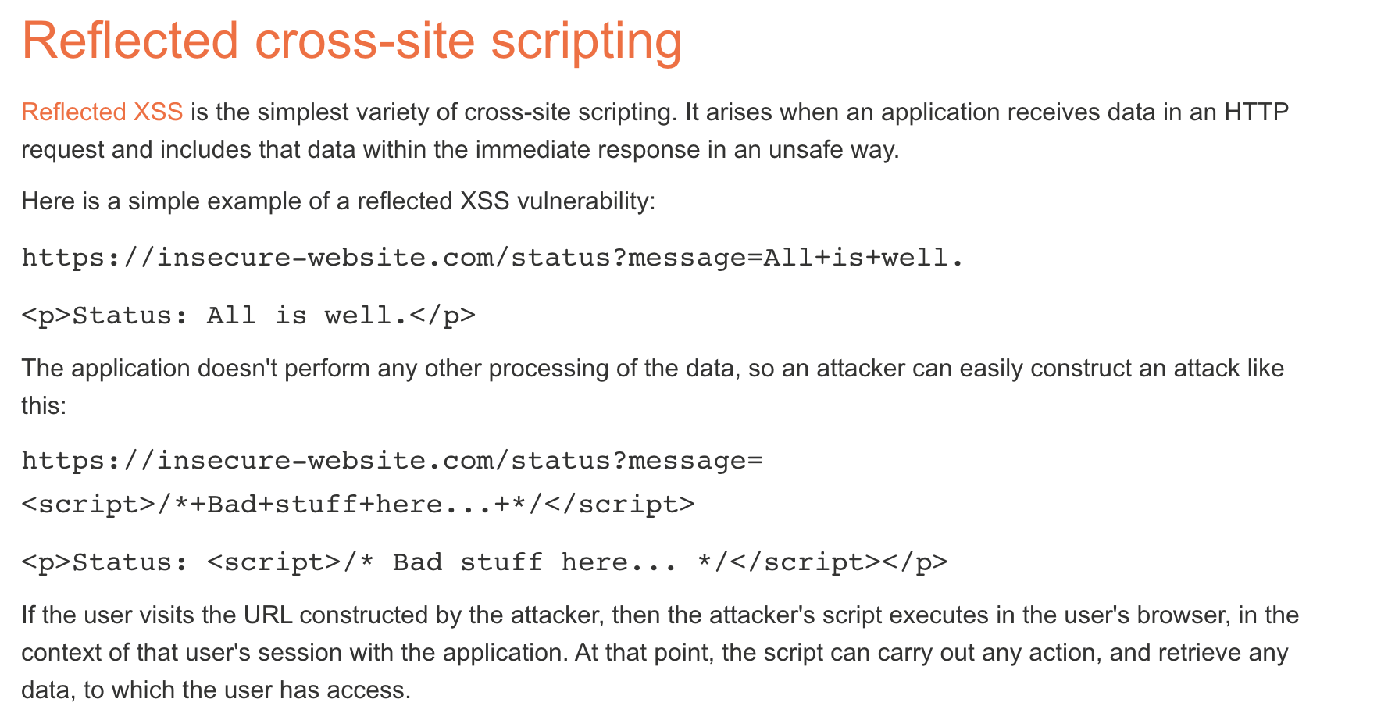
Notes:
https://portswigger.net/web-security/cross-site-scripting

Slide 35
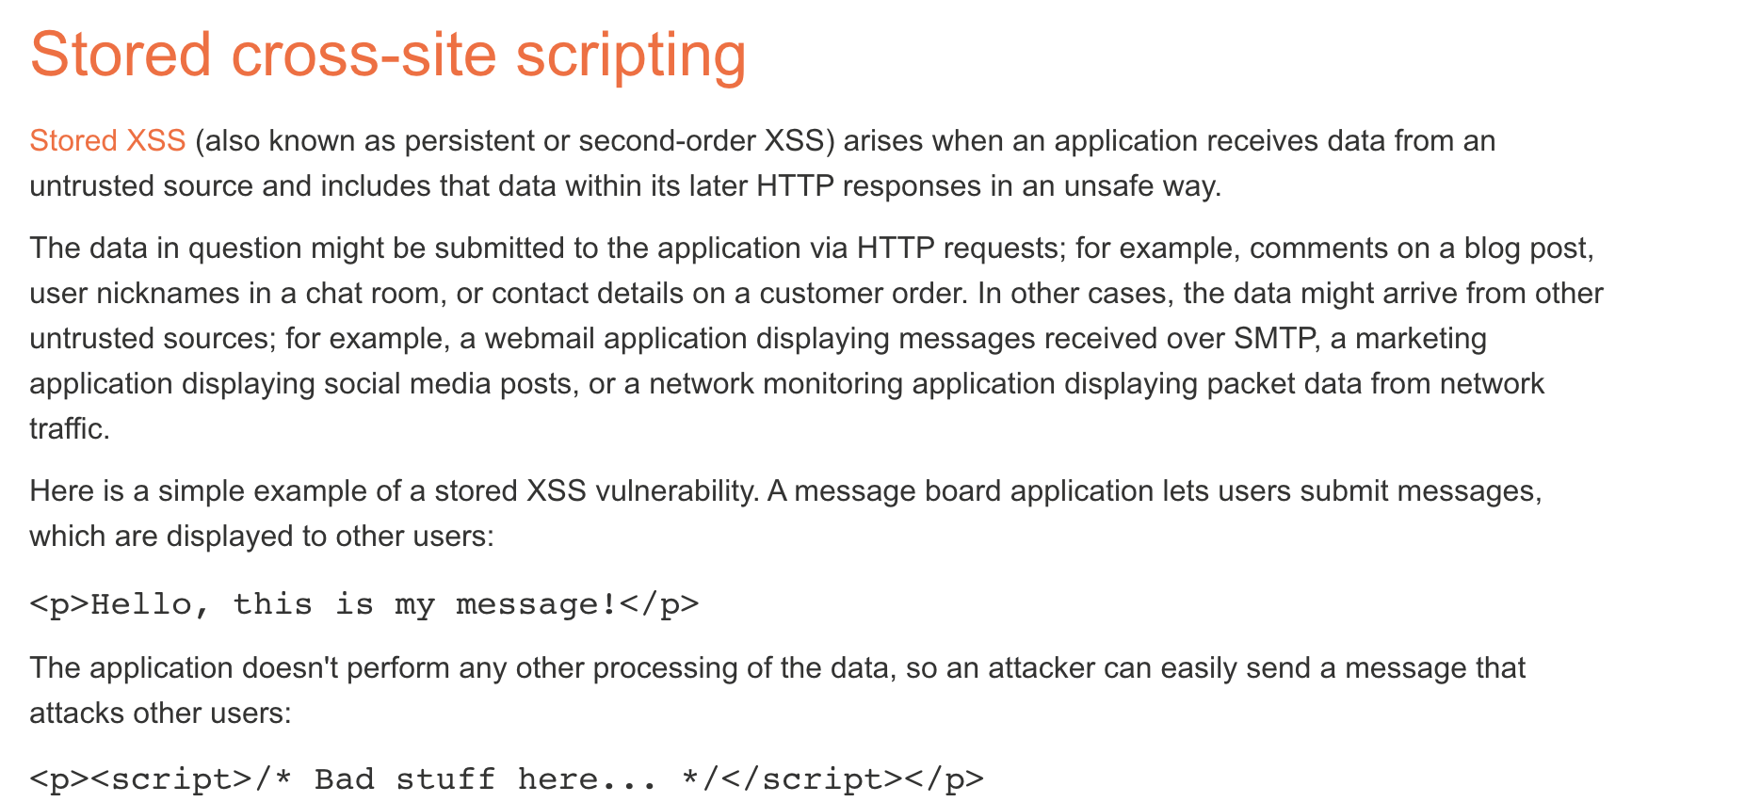

Slide 36
XSS Defenses
Make sure data gets shown as data, not executed as code!
Escape special characters
Which ones? Depends what context your $data is presented
Inside an HTML document? <div>$data</div>
Inside a tag? <a href=“https://site.com/$data”>
Inside Javascript code? var x = “$data”;
Make sure to escape every last instance!
Frameworks can let you declare what’s user-controlled data and automatically escape it

Slide 37
Web Overview (HTTP)
GET / HTTP/1.1 Host: gmail.com
HTTP/1.1 200 OK … <html>
<head>
<script>alert(‘Hi!’)</script>
</head>
<img src=“//gmail.com/img.png”/>
https://gmail.com/ says: Hi!
gmail.com
GET /img.png HTTP/1.1 Host: gmail.com
HTTP/1.1 200 OK … <89>PNG^M ...
Notes:
Fetching image, not script

Slide 38
Cross-site Request Forgery (CSRF)
fde874 = bob
Suppose you log in to bank.com
POST /login?user=bob&pass=abc123 HTTP/1.1 Host: bank.com
bank.com
HTTP/1.1 200 OK Set-Cookie: login=fde874 ….

Slide 39
Cross-site Request Forgery (CSRF)
fde874 = bob
GET /account HTTP/1.1 Host: bank.com
Cookie: login=fde874
bank.com
HTTP/1.1 200 OK ….
$378.42

Slide 40
Cross-site Request Forgery (CSRF)
fde874 = bob
Click me!!! https://bank.com/transfer?to=badguy&amt=100
GET /transfer?to=badguy&amt=100 HTTP/1.1 Host: bank.com
Cookie: login=fde874
bank.com
HTTP/1.1 200 OK ….
Transfer complete: -$100.00

Slide 41
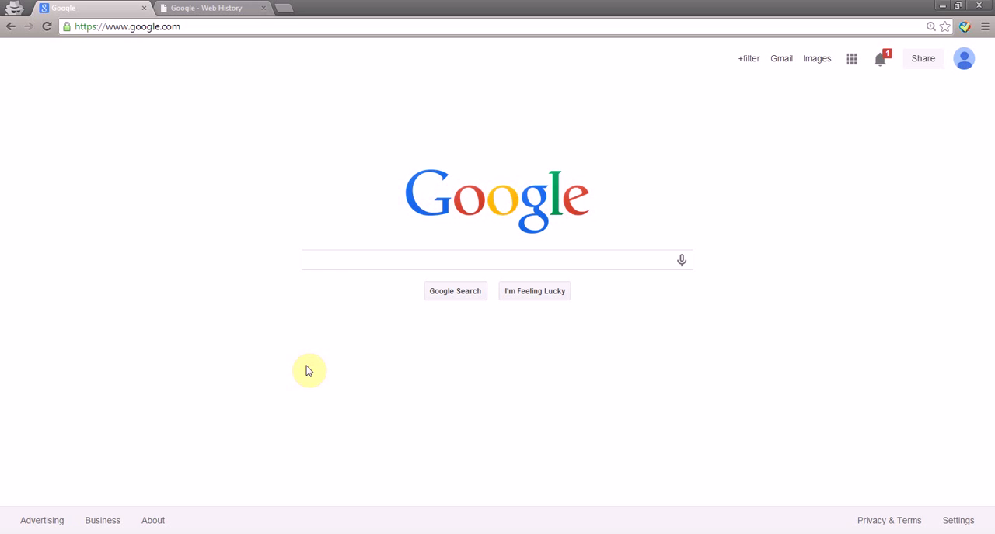
Profile Pollution with CSRF
Take This Personally: Pollution Attacks on Personalized Services. X. Xing, W. Ming, D. Doozan, A. Snoeren, N. Feamster, W. Lee. In USENIX Security Symposium, 2013.

Slide 42
CSRF Defenses
Need to “authenticate” each user action originates from our site
One way: each “action” gets a token associated with it
On a new action (page), verify the token is present and correct
Attacker can’t find token for another user, and thus can’t make actions on the user’s behalf

Slide 43
CSRF Defenses
Pay $25 to Joe: https://bank.com/transfer?to=joe&amt=25&token=8d64
fde874 = bob
<input type="hidden" name=”token" value="8d64" />
HTTP/1.1 200 OK Set-Cookie: token=8d64 ….
bank.com
GET /transfer?to=joe&amt=25&token=8d64 HTTP/1.1 Host: bank.com
Cookie: login=fde874
HTTP/1.1 200 OK ….
Transfer complete: -$25.00

Slide 44
Same-Origin Policy
Origin | Trying to access | Allowed?
https://example.com/a/ | https://example.com/ | Protocol mismatch
https://example.com/a/ | https://example.com/b/ | Yes
https://example.com/ | https://www.example.com/a/ | Host mismatch
https://example.com:81/ | https://example.com/ | Port mismatch
Notes:
SOP answers the question “Can a script with an origin X access a resource loaded from origin Y?”
In a nutshell, X and Y should be “the same.” The slide answers what it means for X and Y to be the same.

Slide 45
What about externally hosted scripts?
Say example.com loads the following JS
<script src="//ajax.googleapis.com/ajax/ libs/jquery/1.10.2/jquery.min.js">
</script>
Can it function normally in spite of SOP?
Yes. The origin of this script is still example.com
Notes:
It looks like if example.com incorporates an externally hosted script (here coming from ajax.googleapis.com) then it won’t be able to function properly because it can’t read example.com cookies.
What’s going on here?
Answer: origins apply to pages and iFrames. They don’t apply at a per-object level. The definition doesn’t care about which domain the script came from. Here the script’s origin is still example.com because that’s the page that did the loading.

Slide 46
SOP Complications
Subtly different policies for
Cookies
HTML5 storage
Plugins
Ambiguities: different browsers, extensions, IP addresses…

Slide 47
Other problems with SOP
Hostnames not an accurate way to define trust boundaries
webhost.com/~alice vs webhost.com/~bob
login.example.com vs payments.example.com
Notes:
No way to fix the first problem
But the second can be fixed. See next slide

Slide 48
What is SSL/TLS?
Transport Layer Security protocol, version 1.3
De facto standard for Internet security
“The primary goal of the TLS protocol is to provide privacy and data integrity between two communicating applications”
In practice, used to protect information transmitted between browsers and Web servers
Based on Secure Sockets Layers protocol, v. 3.0
Same protocol design, different algorithms
Deployed in every Web browser

Slide 49
Application-Level Protection
email, Web, NFS
application
presentation
Protects against application-level threats (e.g., server impersonation), NOT against IP-level threats (spoofing, SYN flood, DDoS by data flood)
RPC
session
TCP
transport
IP
network
802.11
data link
physical

Slide 50
History of the Protocol
SSL 1.0
Internal Netscape design, early 1994?
Lost in the mists of time
SSL 2.0
Published by Netscape, November 1994
Several weaknesses
SSL 3.0
Designed by Netscape and Paul Kocher, November 1996
TLS 1.0
Internet standard based on SSL 3.0, January 1999
Not interoperable with SSL 3.0
TLS uses HMAC instead of MAC; can run on any port

Slide 51
Request for Comments
Network protocols are usually disseminated in the form of an RFC (https://www.ietf.org/rfc/)
TLS version 1.0 is described in RFC 2246
Intended to be a self-contained definition of the protocol
Describes the protocol in sufficient detail for readers who will be implementing it and those who will be doing protocol analysis
Mixture of informal prose and pseudo-code

Slide 52
TLS Basics
TLS consists of two protocols
Familiar pattern for key exchange protocols
Handshake protocol
Use public-key cryptography to establish a shared secret key between the client and the server
Record protocol
Use the secret key established in the handshake protocol to secure communication between client and server
Notes:
We will focus on the handshake protocol

Slide 53
SSL Protocol Architecture
SSL Handshake Protocol
SSL Change Cipher Spec Protocol
SSL Alert Protocol
HTTP, other apps
SSL Record Protocol
TCP

Slide 54
TLS Handshake Protocol
Two parties: client and server
Negotiate version of the protocol and the set of cryptographic algorithms to use
Ensure interoperability between different implementations of the protocol
Authenticate server and (optionally) client
Use digital certificates to learn each other’s public keys and verify each other’s identity
Use public keys to establish a shared secret

Slide 55
Handshake Protocol Structure
ClientHello
S
C
ServerHello,
[Certificate],
[ServerKeyExchange],
[CertificateRequest],
ServerHelloDone
[Certificate],
ClientKeyExchange,
[CertificateVerify]
Finished
switch to negotiated cipher
switch to negotiated cipher
Record of all sent and
received handshake messages
Finished

Slide 56
ClientHello
ClientHello
S
C
Client announces (in plaintext):
Protocol version it is running
Cryptographic algorithms it supports

Slide 57
ClientHello (RFC 5246)
Highest version of the protocol supported by the client
struct {
ProtocolVersion client_version;
Random random;
SessionID session_id;
CipherSuite cipher_suites;
CompressionMethod compression_methods;
} ClientHello
Session id (if the client wants to resume an old session)
Set of cryptographic algorithms supported by the client (e.g., RSA or Diffie-Hellman)
Notes:
https://tools.ietf.org/html/rfc5246

Slide 58
ServerHello
Version_{c}, suite_{c}, N_{c}
S
C
ServerHello
Server responds (in plaintext) with:
Highest protocol version supported by
both client and server
Strongest cryptographic suite selected
from those offered by the client

Slide 59
ServerKeyExchange
Version_{c}, suite_{c}, N_{c}
S
C
Version_{s}, suite_{s}, N_{s},
ServerKeyExchange
Server sends his public-key certificate
containing either its RSA, or
Diffie-Hellman public key
(depending on chosen crypto suite)

Slide 60
ClientKeyExchange
Version_{c}, suite_{c}, N_{c}
S
C
Version_{s}, suite_{s}, N_{s},
sig_{ca}(S,K_{s}),
“ServerHelloDone”
ClientKeyExchange
Client generates some secret key material
and sends it to the server encrypted with
the server’s public key (if using RSA)

Slide 61
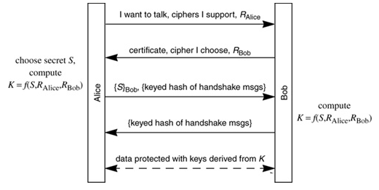
“Core” SSL 3.0 Handshake
The reading shows the above protocol which is the same as the protocol in the previous slide. Find out the correspondence between the different notations that denote the same thing in these two protocols.

Slide 62
“Core” SSL 3.0 Handshake
Version_{c}=3.0, suite_{c}, N_{c}
C
S
Version_{s}=3.0, suite_{s}, N_{s},
sig_{ca}(S,K_{s}),
“ServerHelloDone”
{Secret_{c}}_{Ks}
If the protocol is correct, C and S share
some secret key material (secret_{c}) at this point
switch to key derived
from secret_{c}, N_{c}, N_{s}
switch to key derived
from secret_{c}, N_{c}, N_{s}

Slide 63
Version Downgrade Attack
Version_{c}=2.0, suite_{c}, N_{c}
S
C
Server is fooled into thinking it communicating with a client who supports only SSL 2.0
Version_{s}=2.0, suite_{s}, N_{s},
sig_{ca}(S,K_{s}),
“ServerHelloDone”
{Secret_{c}}_{Ks}
C and S end up communicating using SSL 2.0
(weaker earlier version of the protocol that
does not include “Finished” messages)

Slide 64
SSLv2 Weaknesses (Fixed in SSLv3)
Downgrade attack
Cipher suite preferences are not authenticated
“Cipher suite rollback” attack is possible
Truncation attack
Weak MAC construction
MAC hash uses only 40 bits in export mode
Notes:
No support for certificate chains or non-RSA algorithms, no handshake while session is open

Slide 65
“Chosen-Protocol” Attacks
Why do people release new versions of security protocols?
New version must be backwards-compatible
Not everybody upgrades right away
Attacker can fool parties into using the old, broken version and exploit known vulnerability
Similar: fool victim into using weak crypto algorithms
Defense is hard: must authenticate version early
Many protocols had “version rollback” attacks
SSL, SSH, GSM (cell phones)

Slide 66
Version Check in SSL v3
Version_{c}=3.0, suite_{c}, N_{c}
S
C
Version_{s}=3.0, suite_{s}, N_{s},
sig_{ca}(S,K_{s}),
“ServerHelloDone”
“Embed” version number into secret
Check that received version is equal to the version in ClientHello
{Version_{c},Secret_{c}}_{Ks}
If the protocol is correct, C and S share
some secret key material secret_{c} at this point
switch to key derived
from secret_{c}, N_{c}, N_{s}
switch to key derived
from secret_{c}, N_{c}, N_{s}

Slide 67
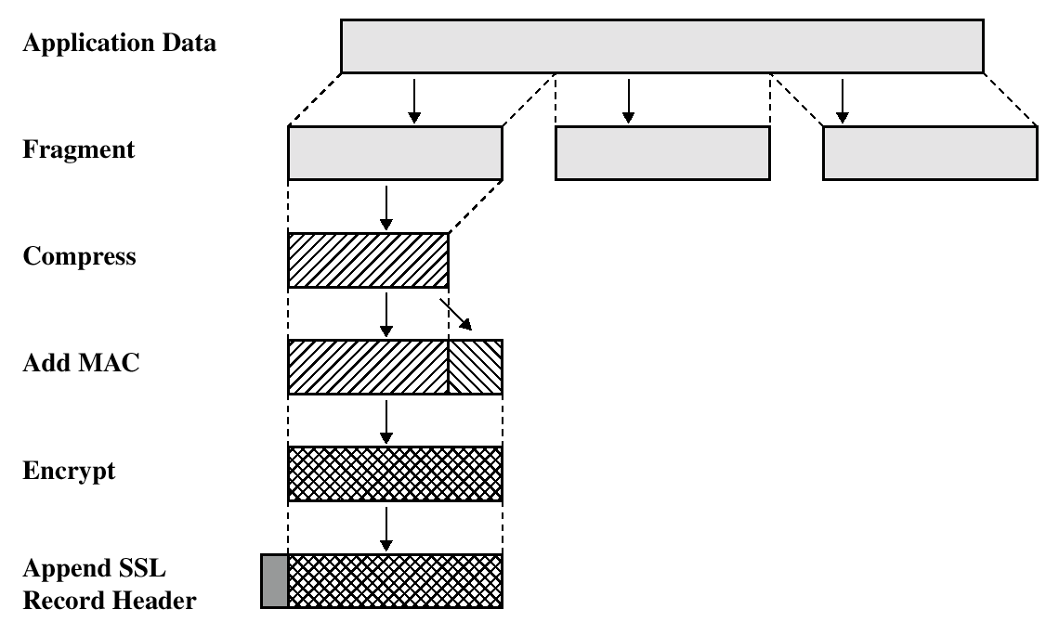
SSL/TLS Record Protection
Use symmetric keys
established in handshake protocol

Slide 68
SSL Handshake Protocol: Additional Features
SSL Handshake Protocol supports session resumption and ciphersuite re-negotiation.
Allows authentication and shared secrets to be reused across multiple connections.
Eg, next webpage from same website.
Allows re-keying of current connection using fresh nonces.
Allows change of ciphersuite during session.
ClientHello quotes old SessionID.
Both sides contribute new nonces, update secret_{c.}
All protected by existing Record Protocol.

Slide 69
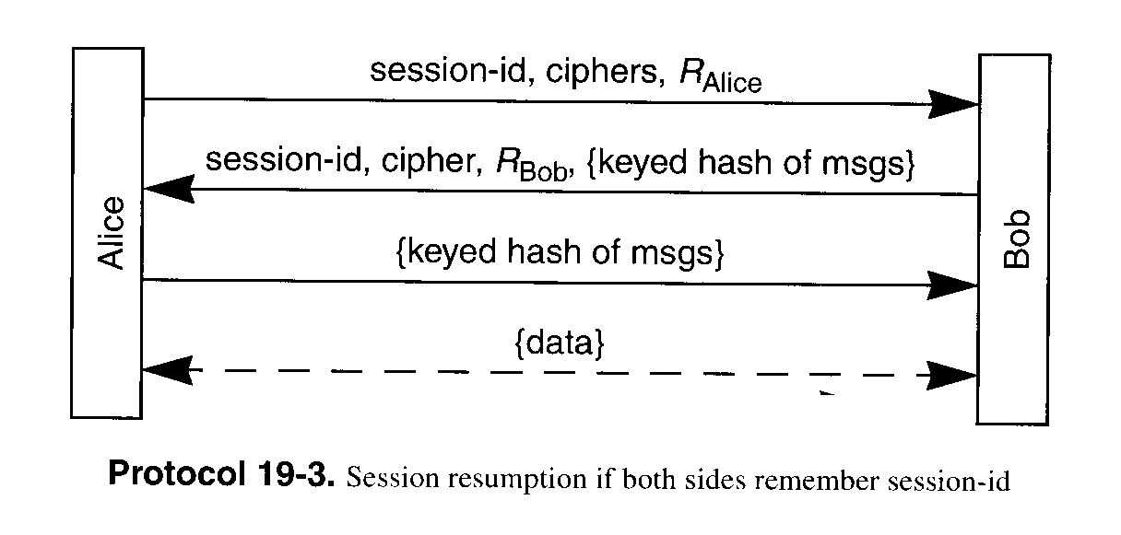
Session Resumption
Avoid public key operation if both sides remember session ID

Slide 70
Some SSL/TLS Security Flaws
(Historical) flaws in random number generation for SSL
Low quality RNG leads to predictable session keys.
Goldberg and Wagner, Dr. Dobb’s Journal, Jan. 1996.
Flaws in error reporting
(differing response times by server in event of padding failure and MAC failure) + (analysis of padding method for CBC-mode) = recovery of SSL plaintext.
Canvel, Hiltgen, Vaudenay and Vuagnoux, Crypto2003.
Timing attacks
analysis of OpenSSL server response times allows attacker in same LAN segment to derive server’s private key!
Boneh and Brumley, 12th Usenix Security Symposium.

Slide 71


Slide 72
TLS Heartbeat Extension
DTLS is designed to secure traffic running on top of unreliable
transport protocols. Usually, such protocols have no session
management. The only mechanism available at the DTLS layer to figure
out if a peer is still alive is a costly renegotiation, particularly
when the application uses unidirectional traffic. Furthermore, DTLS
needs to perform path MTU (PMTU) discovery but has no specific
message type to realize it without affecting the transfer of user
messages.
TLS is based on reliable protocols, but there is not necessarily a
feature available to keep the connection alive without continuous
data transfer.
The Heartbeat Extension as described in this document overcomes these
limitations. The user can use the new HeartbeatRequest message,
which has to be answered by the peer with a HeartbeartResponse
immediately.

Slide 73
OpenSSL “Heartbleed” Bug
Announced April 2014.
Exploits a programming mistake in the OpenSSL implementation of the TLS ``heartbeat hello’’ extension.
Heartbeat protocol is used to keep a TLS connection alive without continuously transferring data.
One endpoint (e.g., a Web browser) sends a HeartbeatRequest message containing a payload to the other endpoint (e.g. a Web server). The server then sends back a HeartbeatReply message containing the same payload.
“Buffer over-read” error caused by a failure to check for an invalid read-length parameter.

Slide 74
From RFC 6520
Heartbeat Request and Response Messages
The Heartbeat protocol messages consist of their type and an arbitrary
payload and padding.
struct {
HeartbeatMessageType type;
uint16 payload_length;
opaque payload[HeartbeatMessage.payload_length];
opaque padding[padding_length];
} HeartbeatMessage;
The total length of a HeartbeatMessage MUST NOT exceed 2^14 or
max_fragment_length when negotiated as defined in [RFC6066].
type: The message type, either heartbeat_request or heartbeat_response.
payload_length: The length of the payload.
payload: The payload consists of arbitrary content.
padding: The padding is random content that MUST be ignored by the receiver.
Problem: no check that payload_length matches the actual length of the payload

